Slide 1
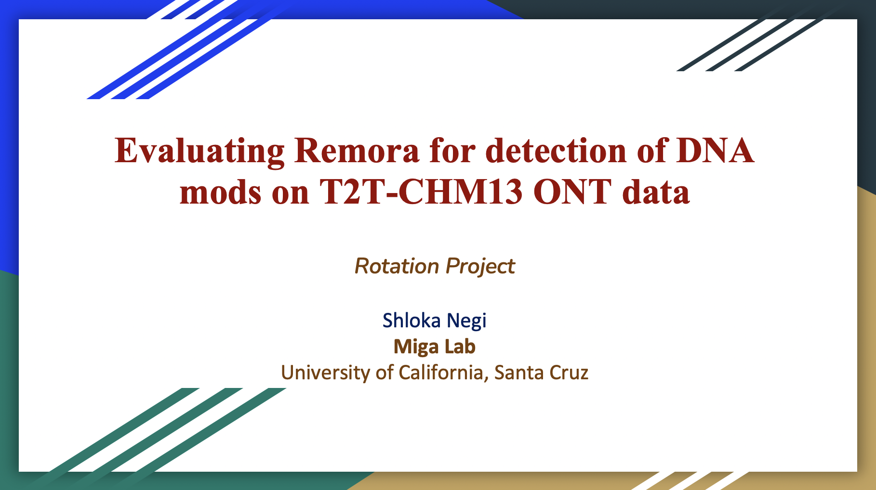


Slide 2
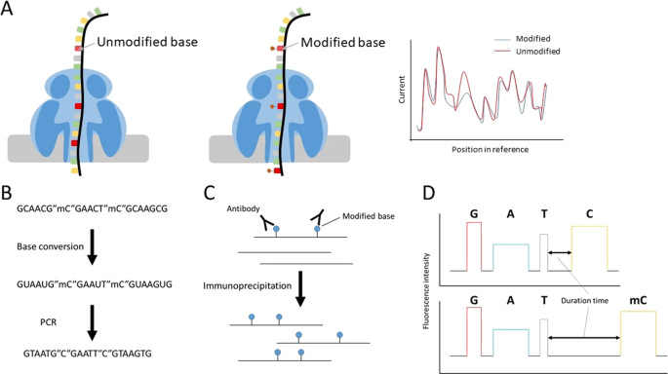
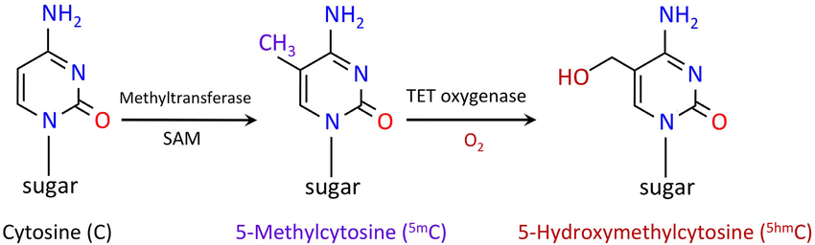
MOTIVATION
Long-read Nanopore Sequencing
Using REMORA to detect the mods. Several advantages over Megalodon and Guppy –
Separates canonical base calling & modified base calling
Reduces overall time
High accuracy
Simple training dataset
DNA modifications
REMORA : https://github.com/nanoporetech/remora
Notes:
We know that long-read nanopore sequencing paved way for direct detection of methylation on the DNA sequence. Since then there have been many modbase callers which detect mods on these long reads.
Some time back, ONT launched Remora, where they claimed it to provide the highest accuracy methylation detection from nanopore data.
It separates basecalling and modified base calling, reduces overall time and is very accurate.
Remora works on a simple training dataset, which eventually allows high accuracy 5hmC calls as well.

Slide 3
PIPELINE
CHM13 aligned file (without mods)
(BAM)
Extract chrX reads
Samtools view
ChrX read IDs
(TXT)
CHM13 ONT reads
(FAST5)
fast5_subset
Mod base-calling
Guppy basecaller w/ Remora
ChrX ONT reads
(FAST5)
5mC mode
5mC + 5hmC mode
Unmapped BAMs (with only mC mods)
Unmapped BAMs (with both mC and hmC mods)
Samtools fastq | minimap2 | samtools sort
Alignment
CHM13_chrX_merged_aligned_mod.BAM
Extract Mod locations
Reference – T2T-CHM13 (ChrX)
modbam2bed
Genomic coordinates of mods
(BED)
Downstream analysis….
Downstream analysis….

Slide 4
MM tag - position of Cs which might be modified.
ML tag – probability of Cs being modified
probability of C being mC
Single mode
Dual mode
probability of C being mC
probability of C being hmC
ML
Single: 5mC 0.4 10.2 3.5 0
Dual: 5mC 0 5.9 0 2.7
5hmC 98.8 64.5 2 11.3
C
C
C
C
READ

Slide 5
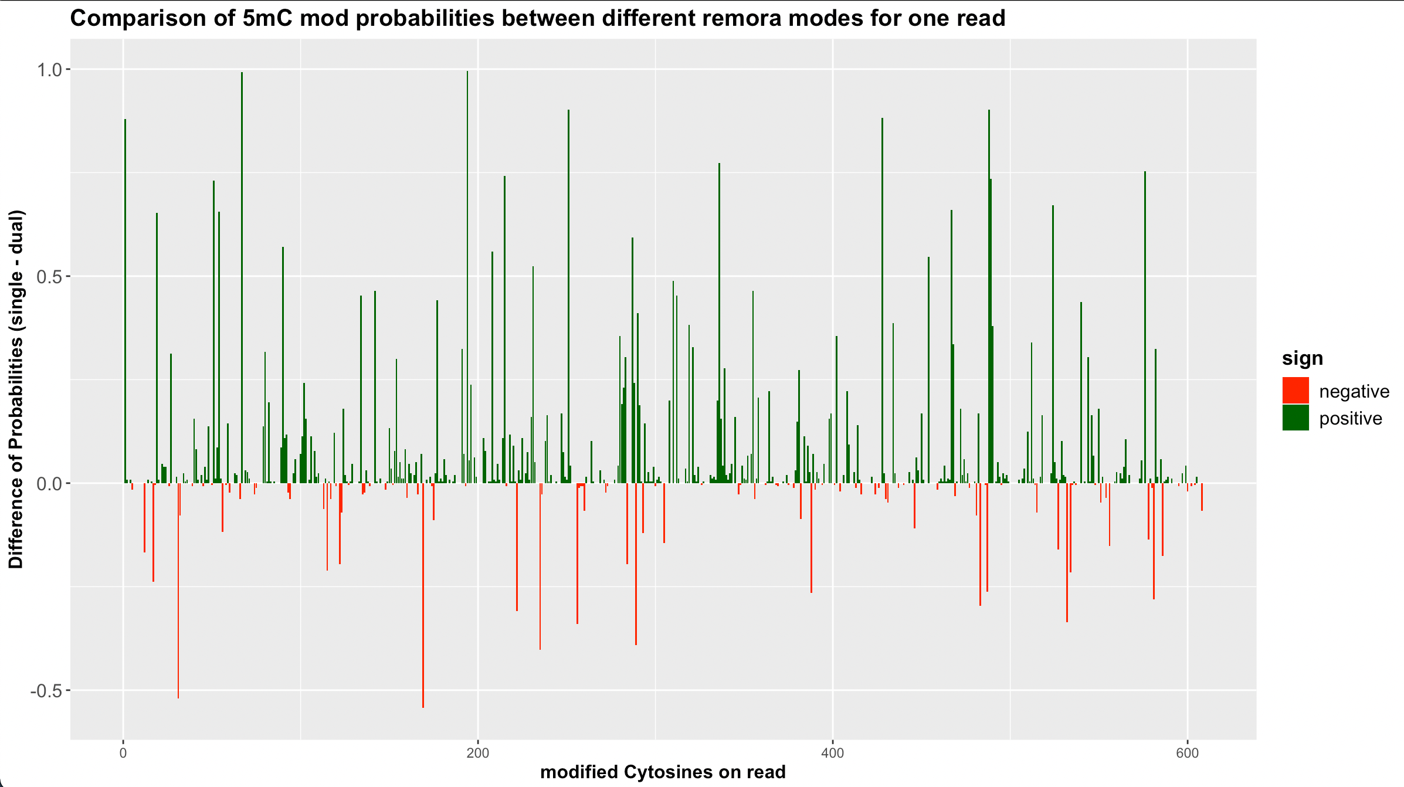
SINGLE is better!
Notes:
Green bars represent positive values => the positions where the single mode is more confident than the dual mode.
Red represents the opposite
Just by a glance, the trend looks clear. It tells us that by using the single mode, we are get more confident mC calls, as compared to dual mode.

Slide 6
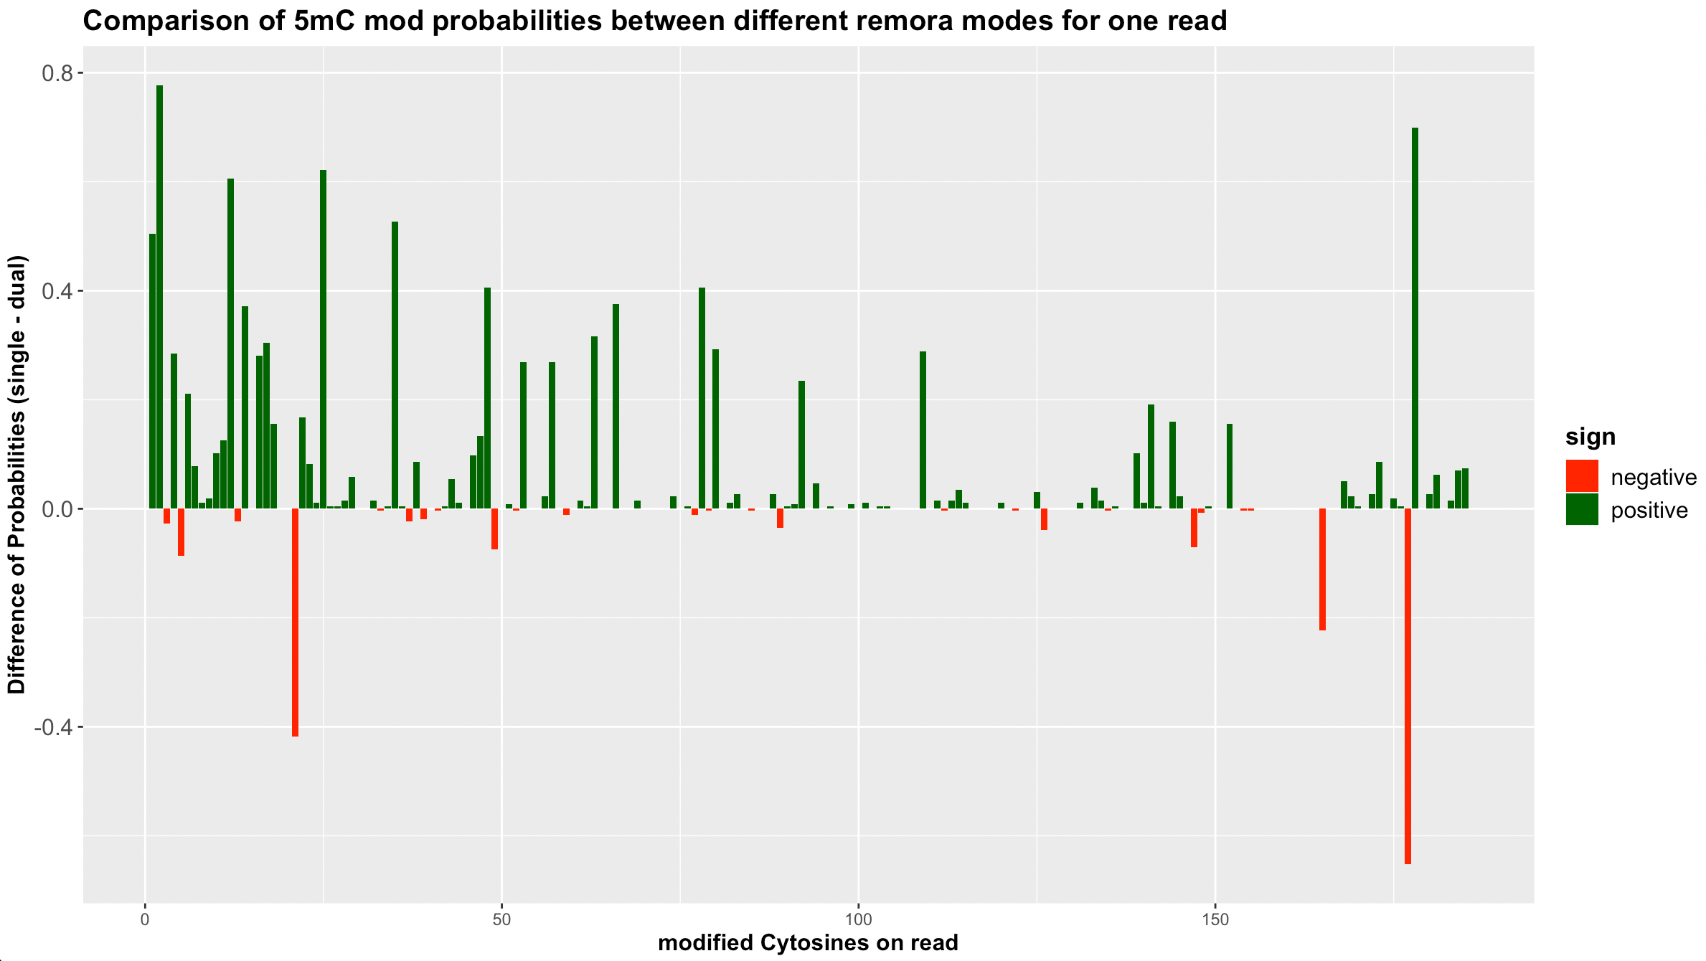

Slide 7
BUT…….

Slide 8
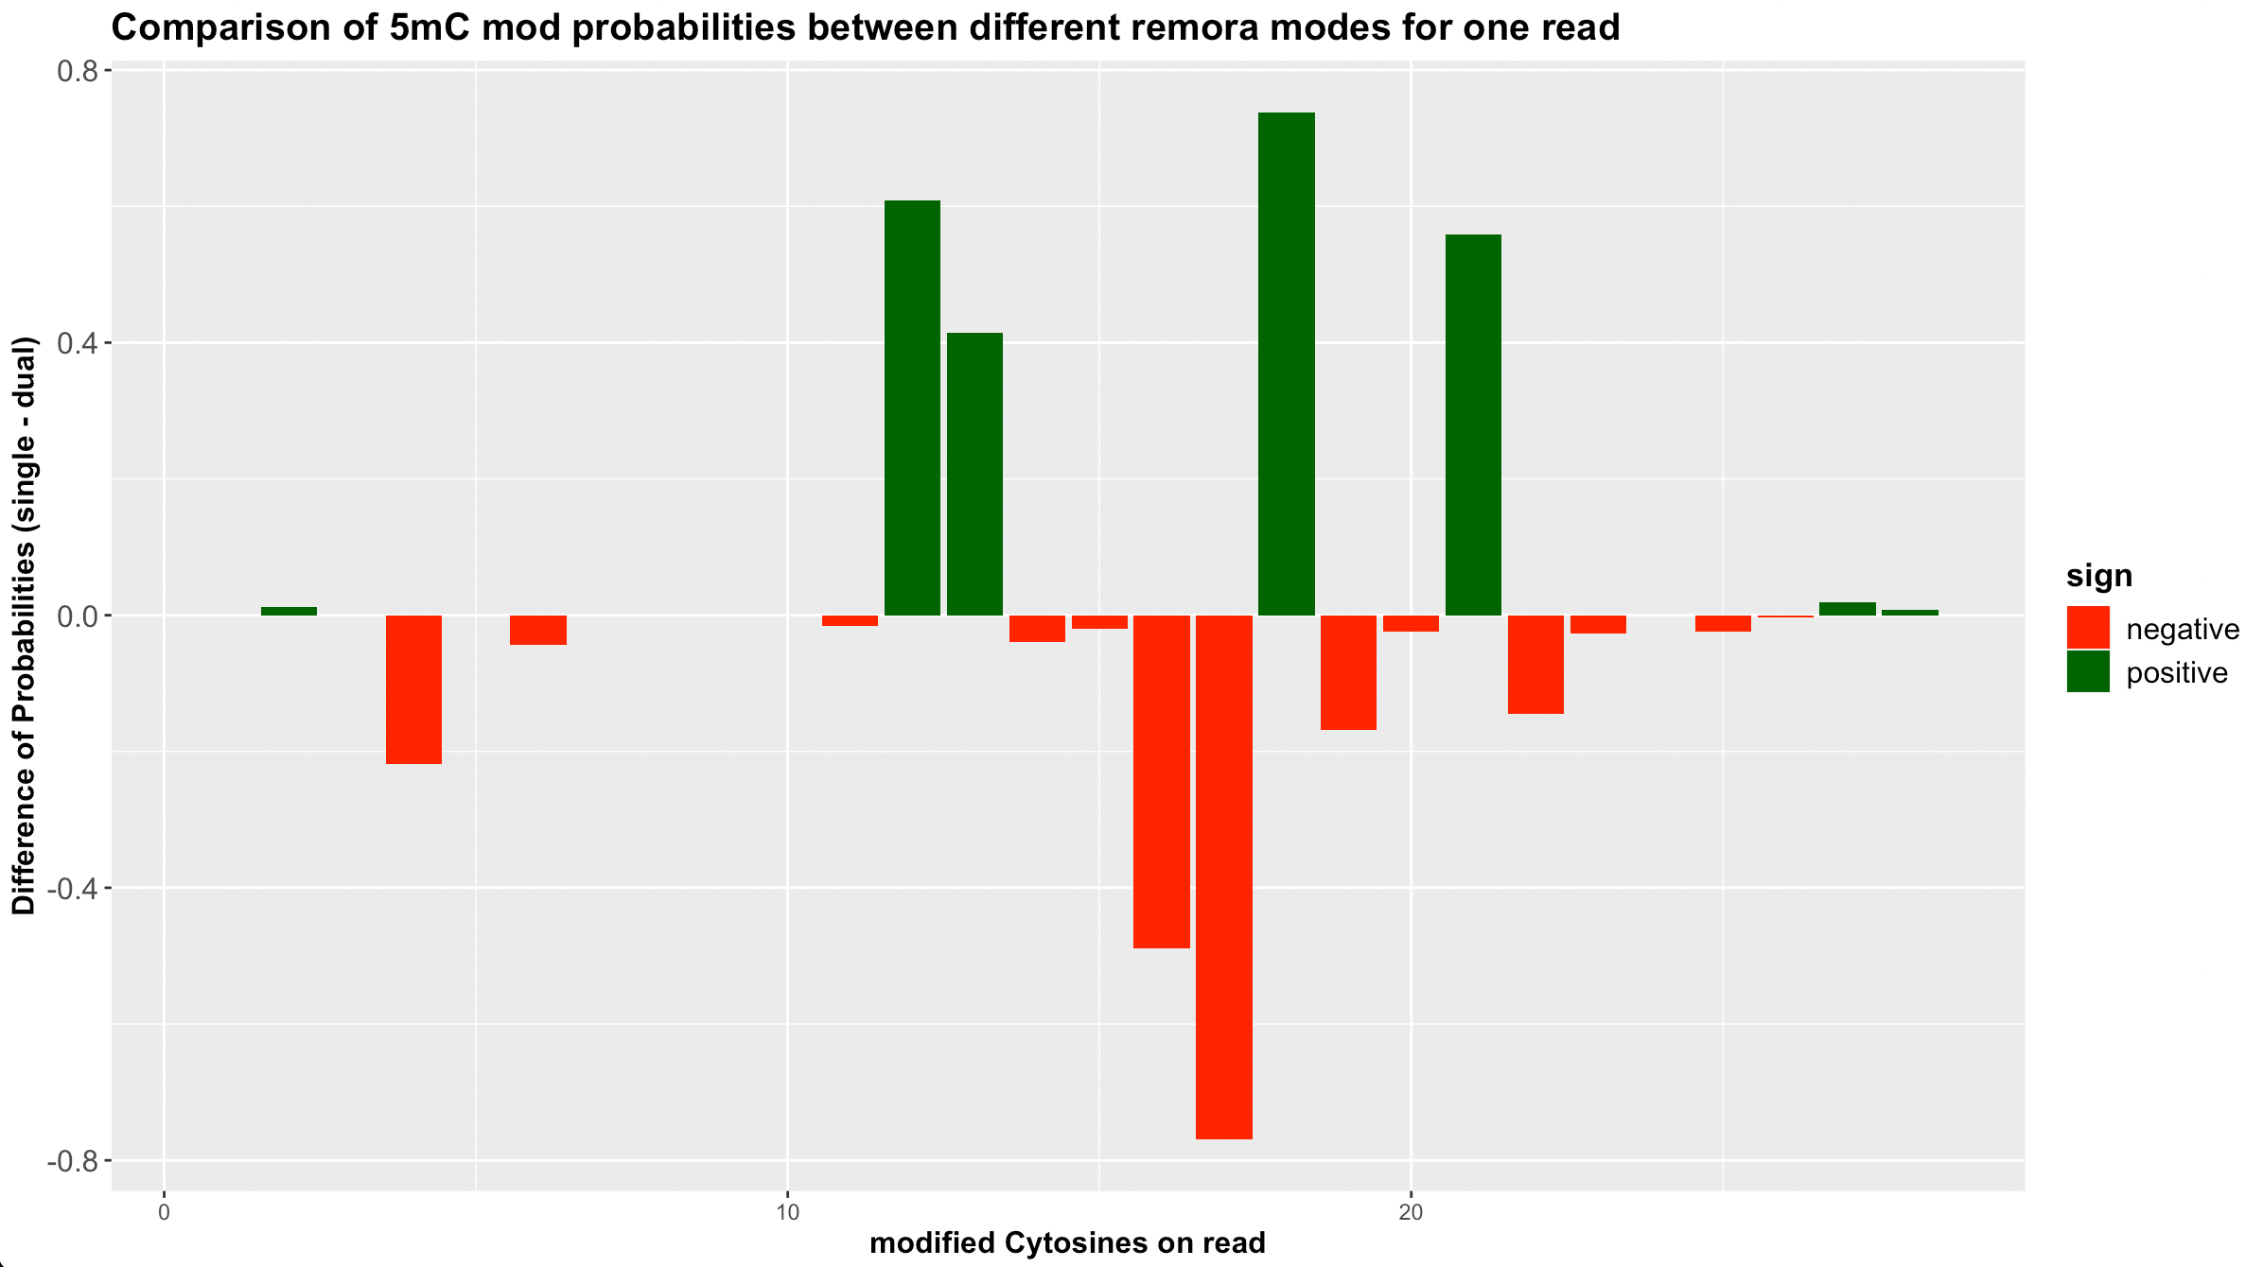
DUAL is Better?
Notes:
There were also cases/reads which showed a trend like this. The dual seems to be performing better?

Slide 9
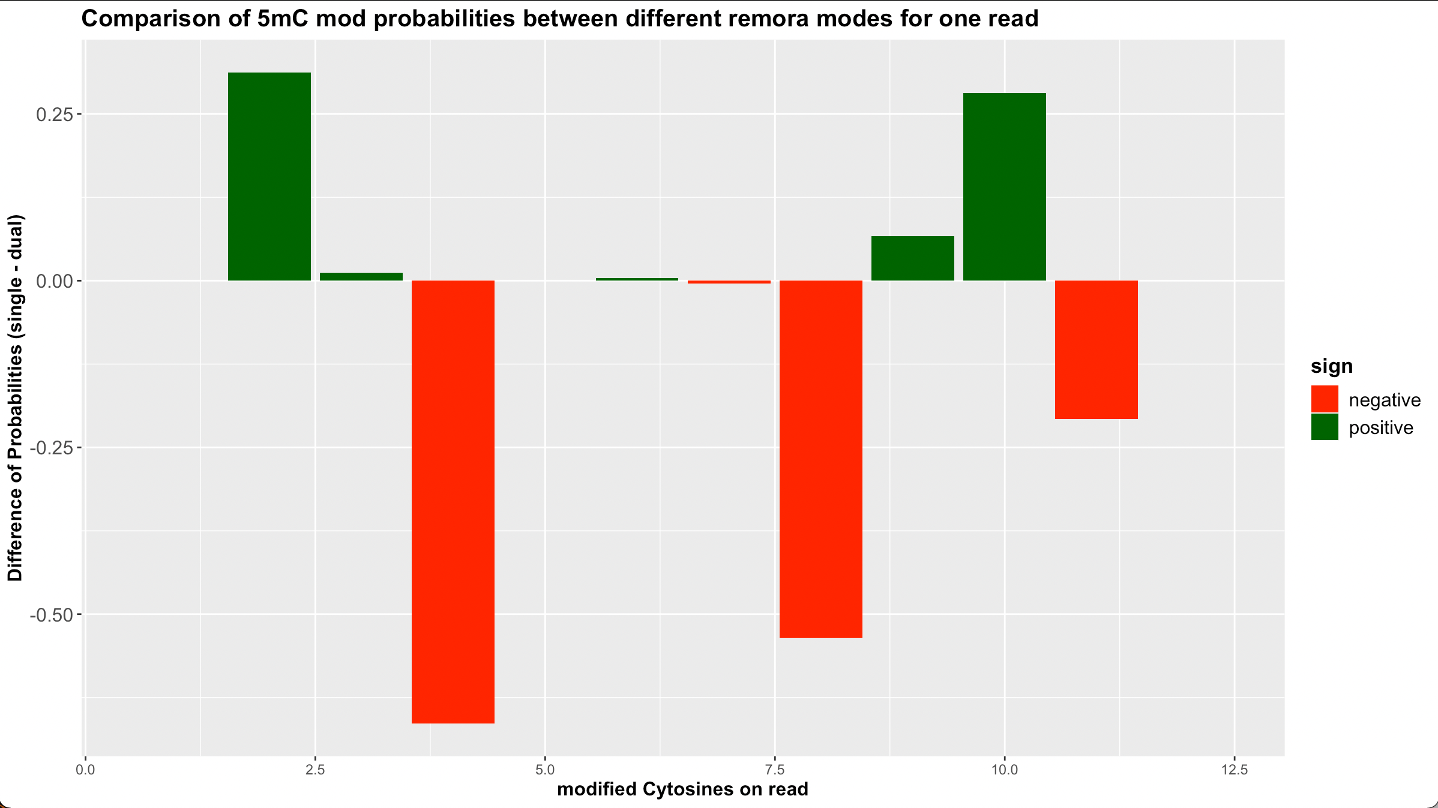
Notes:
So basically, we couldn’t say with surety which mode is actually detecting the mC modifications with more confidence? To deal with this, Karen suggested and we decided to do Benchmarking!

Slide 10
BENCHMARKING with HG002
“Truth” Dataset
(mC mods detected by Bisulfite Sequencing)
“Single” Dataset
(mC mods detected on nanopore data, with remora mode = “only mC” )
“Dual” Dataset
(mC mods detected on nanopore data, with remora mode = “hmC & mC” )
Mapped on hg38
Notes:
Now the idea was to look at the overlap between them to see how much of the TRUTH data is being observed in both the single dataset and the dual dataset

Slide 11
Total number of mod sites identified
Labelled 5mC
(“Truth”)
Called 5mC
(SINGLE mode)
Labelled 5mC
(“Truth”)
Called 5mC
(DUAL mode)
69,431
2,429,494
1,68,437
69,431
2,429,494
168,437
2,498,925
2,498,925
2,597,931
2,597,931
Exactly the same…..
Notes:
We see this similarity because I didn’t filter our BED file. So, it’s actually showing all the locations of where a mod was identified, but it’s not looking at the probability scores of that mod being identified.

Slide 12
High confidence mods, setting threshold to 90%
Labelled 5mC
(“Truth”)
Labelled 5mC
(“Truth”)
Called 5mC
(SINGLE mode)
Called 5mC
(DUAL mode)
PPV(single) = 0.929
>
PPV(dual) = 0.928
1,180,887
1,318,038
99,563
1,330,312
1,168,613
89,824
2,498,925
2,498,925
1,417,601
1,258,437
Now we see a difference……..
Notes:
Setting a threshold of 90% means that at a particular cytosine in the genome, if there are < 90% of the reads which are saying that the cytosine is modified, then we filter those positions.
PPV (Positive Predictive Value) = TP/ (TP + FP)

Slide 13
High confidence mods (TRUTH generated by nanopore seq)
Called 5mC
(SINGLE mode)
Called 5mC
(DUAL mode)
Labelled 5mC
(“Truth”)
Labelled 5mC
(“Truth”)
PPV(single) = 0.478
>
PPV(dual) = 0.472
664,864
120,533
678,734
738,867
205,694
593,573
799,267
799,267
1,417,601
1,258,437

Slide 14
Coming to our original T2T-CHM13, comparing high confidence mods
SINGLE mode
DUAL mode
145,885
136,887
13,693
282,772
150,580
Notes:
Since, I did not have a bisulfite sequencing BED file for CHM13 mC mods, I overlapped the 2 BED files from “single” & “dual” mode.
Single mode is giving us more high confidence mods.
But, without a validation set, it’s difficult to comment that all high confidence mods are actually true mods.
An explanation for having lesser high confidence 5mC mods in the DUAL set is that it is also looking for 5hmC mods. SINGLE mode on the other hand doesn’t have the privilege of looking at 5hmC modifications or any other kind of modifications, so it might be possible that it is making many false 5mC calls.

Slide 15
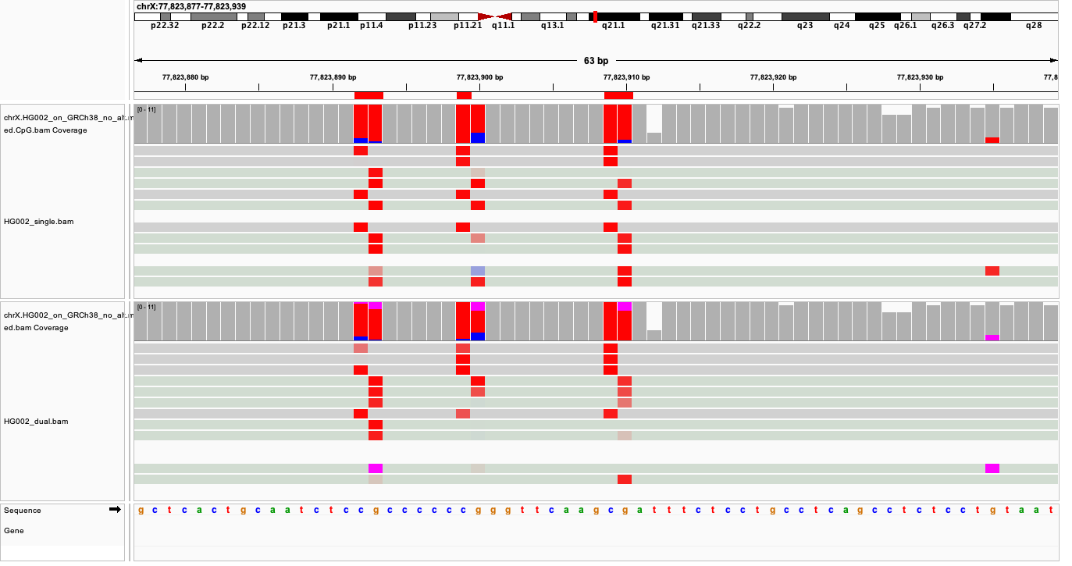
High confidence BED file (single)
78%
99%
Notes:
We see pink rectangles – means an 5hmC modification.
The single mode says that this C is actually 5mC by 78% surety. But, the dual mode says with 99% surety that it was actually 5hmC! So, there might be several such locations where such conflict of interests might be happening. And that’s the fluctuation we were seeing on our difference bar graphs initially
But, the overall consensus is pretty much the same. The majority is still 5mC and hence we label that C as 5mC mod. And probably this is why we get a very similar PPV value.

Slide 16
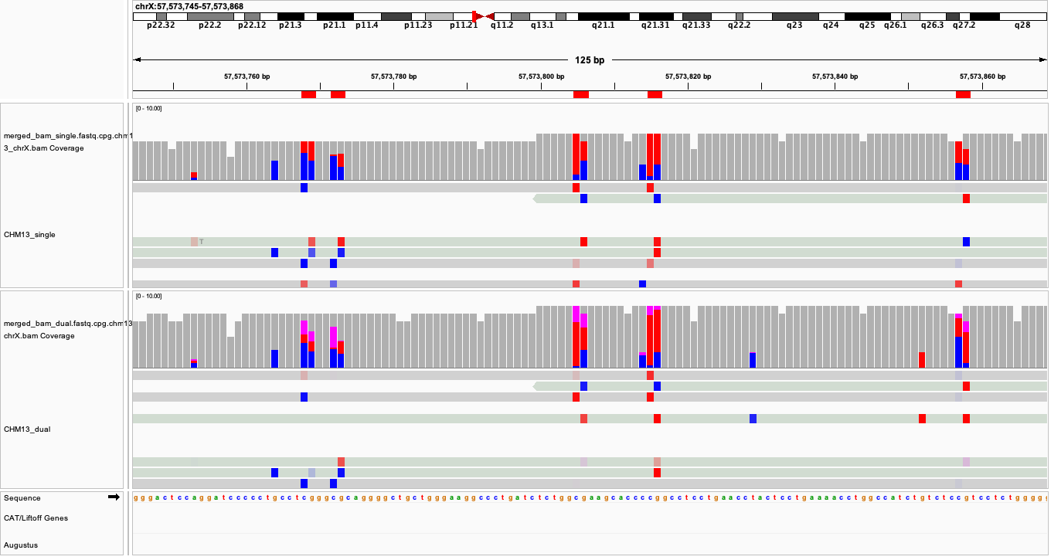
Zooming into g-Sat region
Notes:
- Now let’s see on CHM13. I have zoomed into the “g-Sat” region here. With the dual mode, we see more coverage (height of bars) and a lot more 5hmC mods.

Slide 17
High confidence 5hmC modifications on T2T-CHM13, ChrX
2,630,600
5hmC modifications
1,924
High confidence

Slide 18
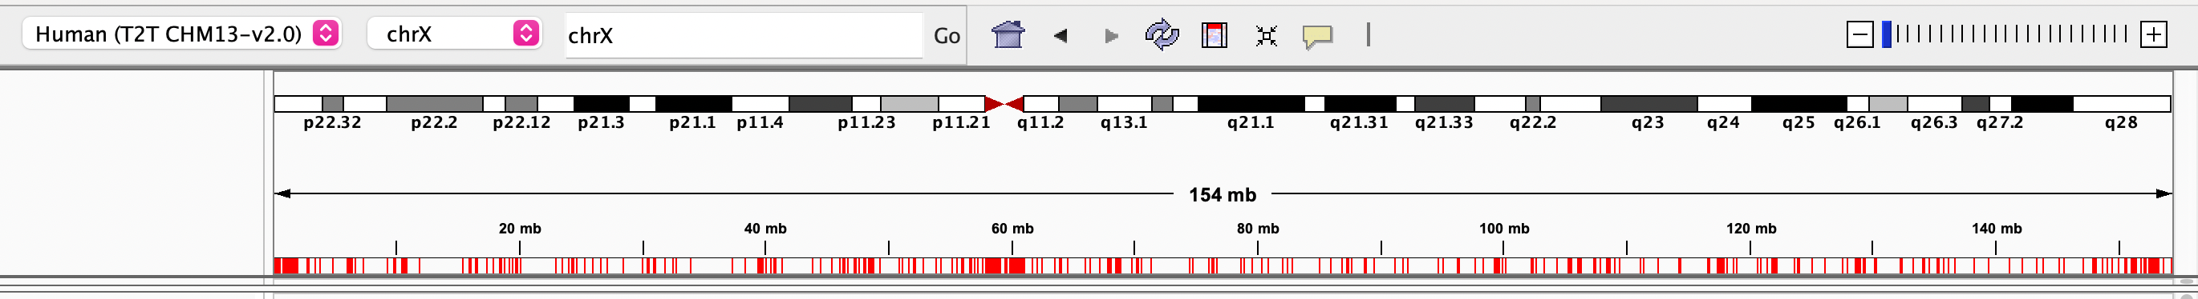
Where are these 5hmC mods concentrated?
Notes:
At the telomeres and the centromere

Slide 19
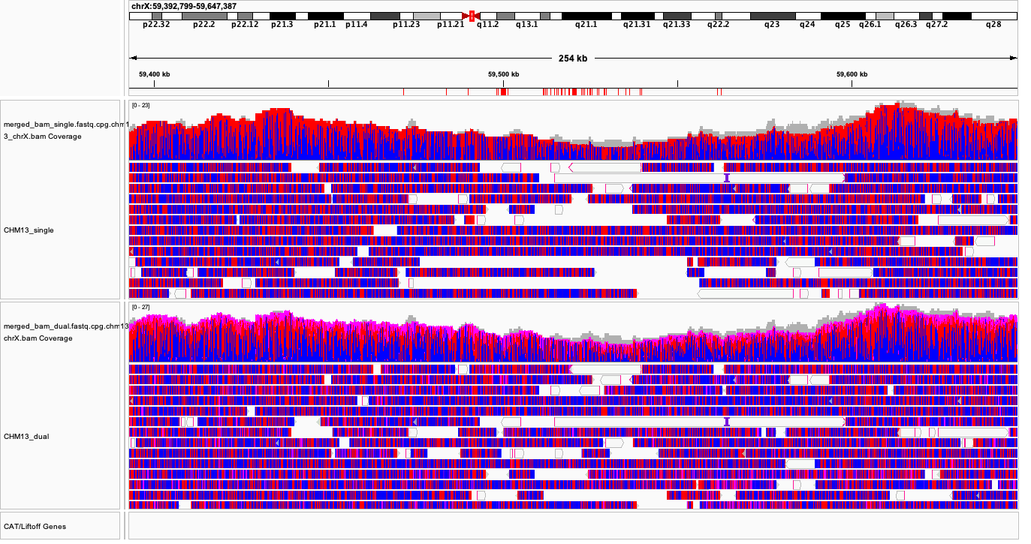
Notes:
A zoomed out view of how concentrated the 5hmCs are at the centromeric region. NOTE: This is just with less that 1/4th FAST5 reads. I’m sure we will get a better visualization if we use all the reads.

Slide 20

ACKNOWLEDGEMENTS
Miga Lab
Karen Miga – For giving me the opportunity to work on such an interesting project, and helping with wonderful ideas and inputs throughout.
Monika Cechova – For working so closely with me on this project and helping me fill the gaps in my knowledge. For all the support throughout.

